Slide 1
Facilities Department
Overview and Update
SRVUSD Board of Education Meeting
5.18.21

Slide 2
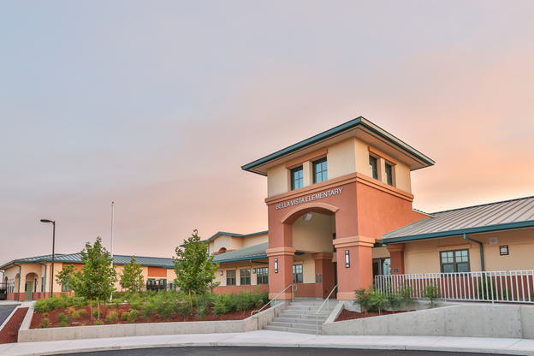
Introduction / Agenda
What does the facilities department do?
Where does the funding come from to do the work?
What is the department working on right now?
Bella Vista Elementary

Slide 3
The Facilities Development Department
Facilitates the construction and renovation of district facilities
Manages all building projects in the district
Modernization and new construction projects
Typically the projects involving more than a single trade or sub-contractor
Growth Projects
Track enrollment and demographic trends, as well as new housing developments
Planning for capacity
Facility rentals to the public and community
Coordinates and interfaces with members of the public to utilize district facilities during non-school hours

Slide 4
What does the facilities department do?
Responsible for the successful implementation of local general obligation bond programs (GO Bond)
Measure D (1998), Measure A (2002), Measure D (2012)
Support the Facilities Oversight and Advisory Committee (FOAC)
Oversight: legal requirement to oversee the use of the bond proceeds
Advisory: Board of Education expectation that the committee provide staff with input and guidance on facility projects

Slide 5
Funding for Projects
Local General Obligation Bonds (GO Bonds)
Measure D (1998) $70 Million
Measure A (2002) $260 Million
Measure D (2012) $260 Million
State Facilities Program (see slides 6-8)
State/Federal/Other Programs
CA Energy Commission - Energy Efficiency Prop 39 - $6.4 Million

Slide 6
State Facilities Program (SFP)
Source: www.dgs.ca.gov/OPSC

Slide 7
State Facilities Program (SFP)
Success in securing SFP dollars to enhance SRVUSD projects
SRVUSD has been granted over $371 million dollars in the 20+ years of the SFP
12.6 m in unfunded applications
Source: www.dgs.ca.gov/OPSC

Slide 8
SFP Fund Release by District - Comparison
Source: www.dgs.ca.gov/OPSC

Slide 9
Upcoming Project / Projects Out to Bid
Alamo Elementary School - two classroom replacement
California High School - kitchen renovation
San Ramon Valley High School - power undergrounding
Sycamore Valley Elementary School - carpet installation
Vista Grande Elementary School - covered walkway and kinder shade structure repairs
Alamo Elementary School - breezeways demolition and roofing replacement
California High School - growth relocatables / site utilities
California, Monte Vista, and San Ramon Valley High Schools - synthetic turf replacement
Monte Vista High School - swimming pool renovation
Venture School - Science and Art classrooms remodel

Slide 10
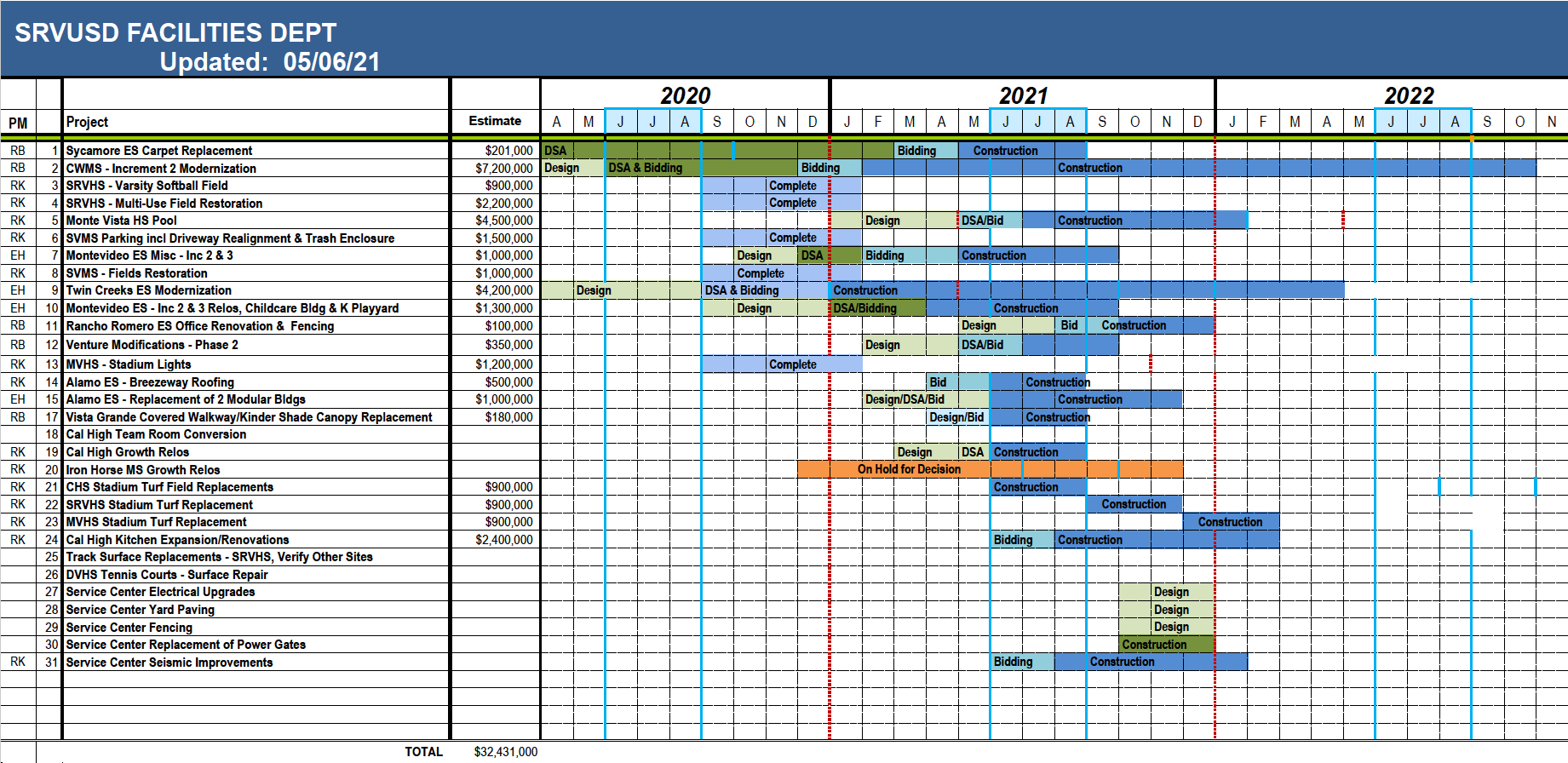
What is the facilities department working on right now?

Slide 11
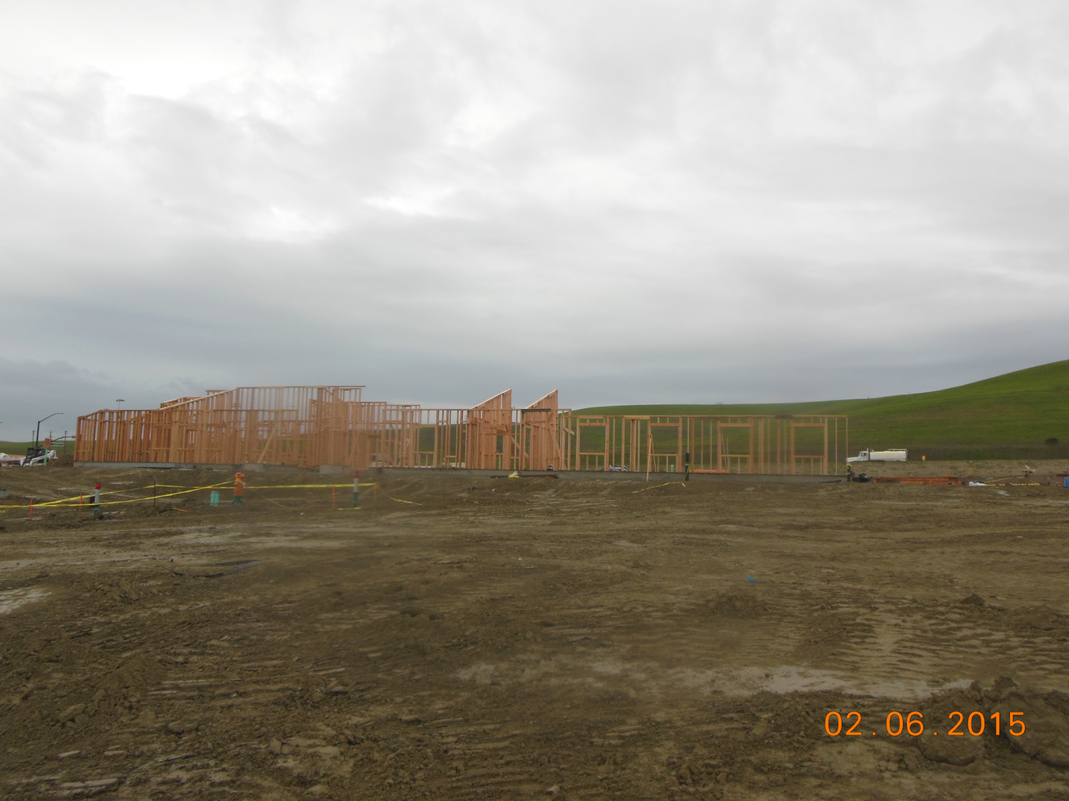
New Construction - Bella Vista Elementary

Slide 12
New Construction - Bella Vista Elementary

Slide 13
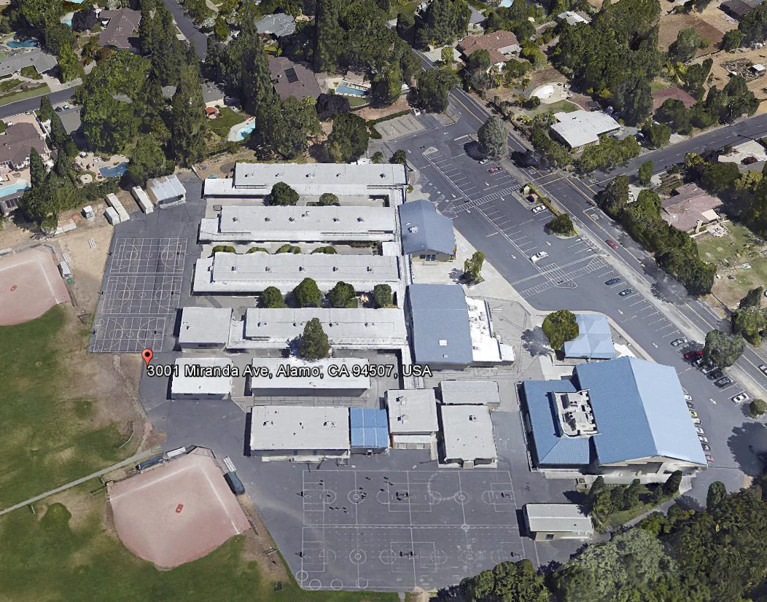
New Construction - Stone Valley Middle
Before

Slide 14
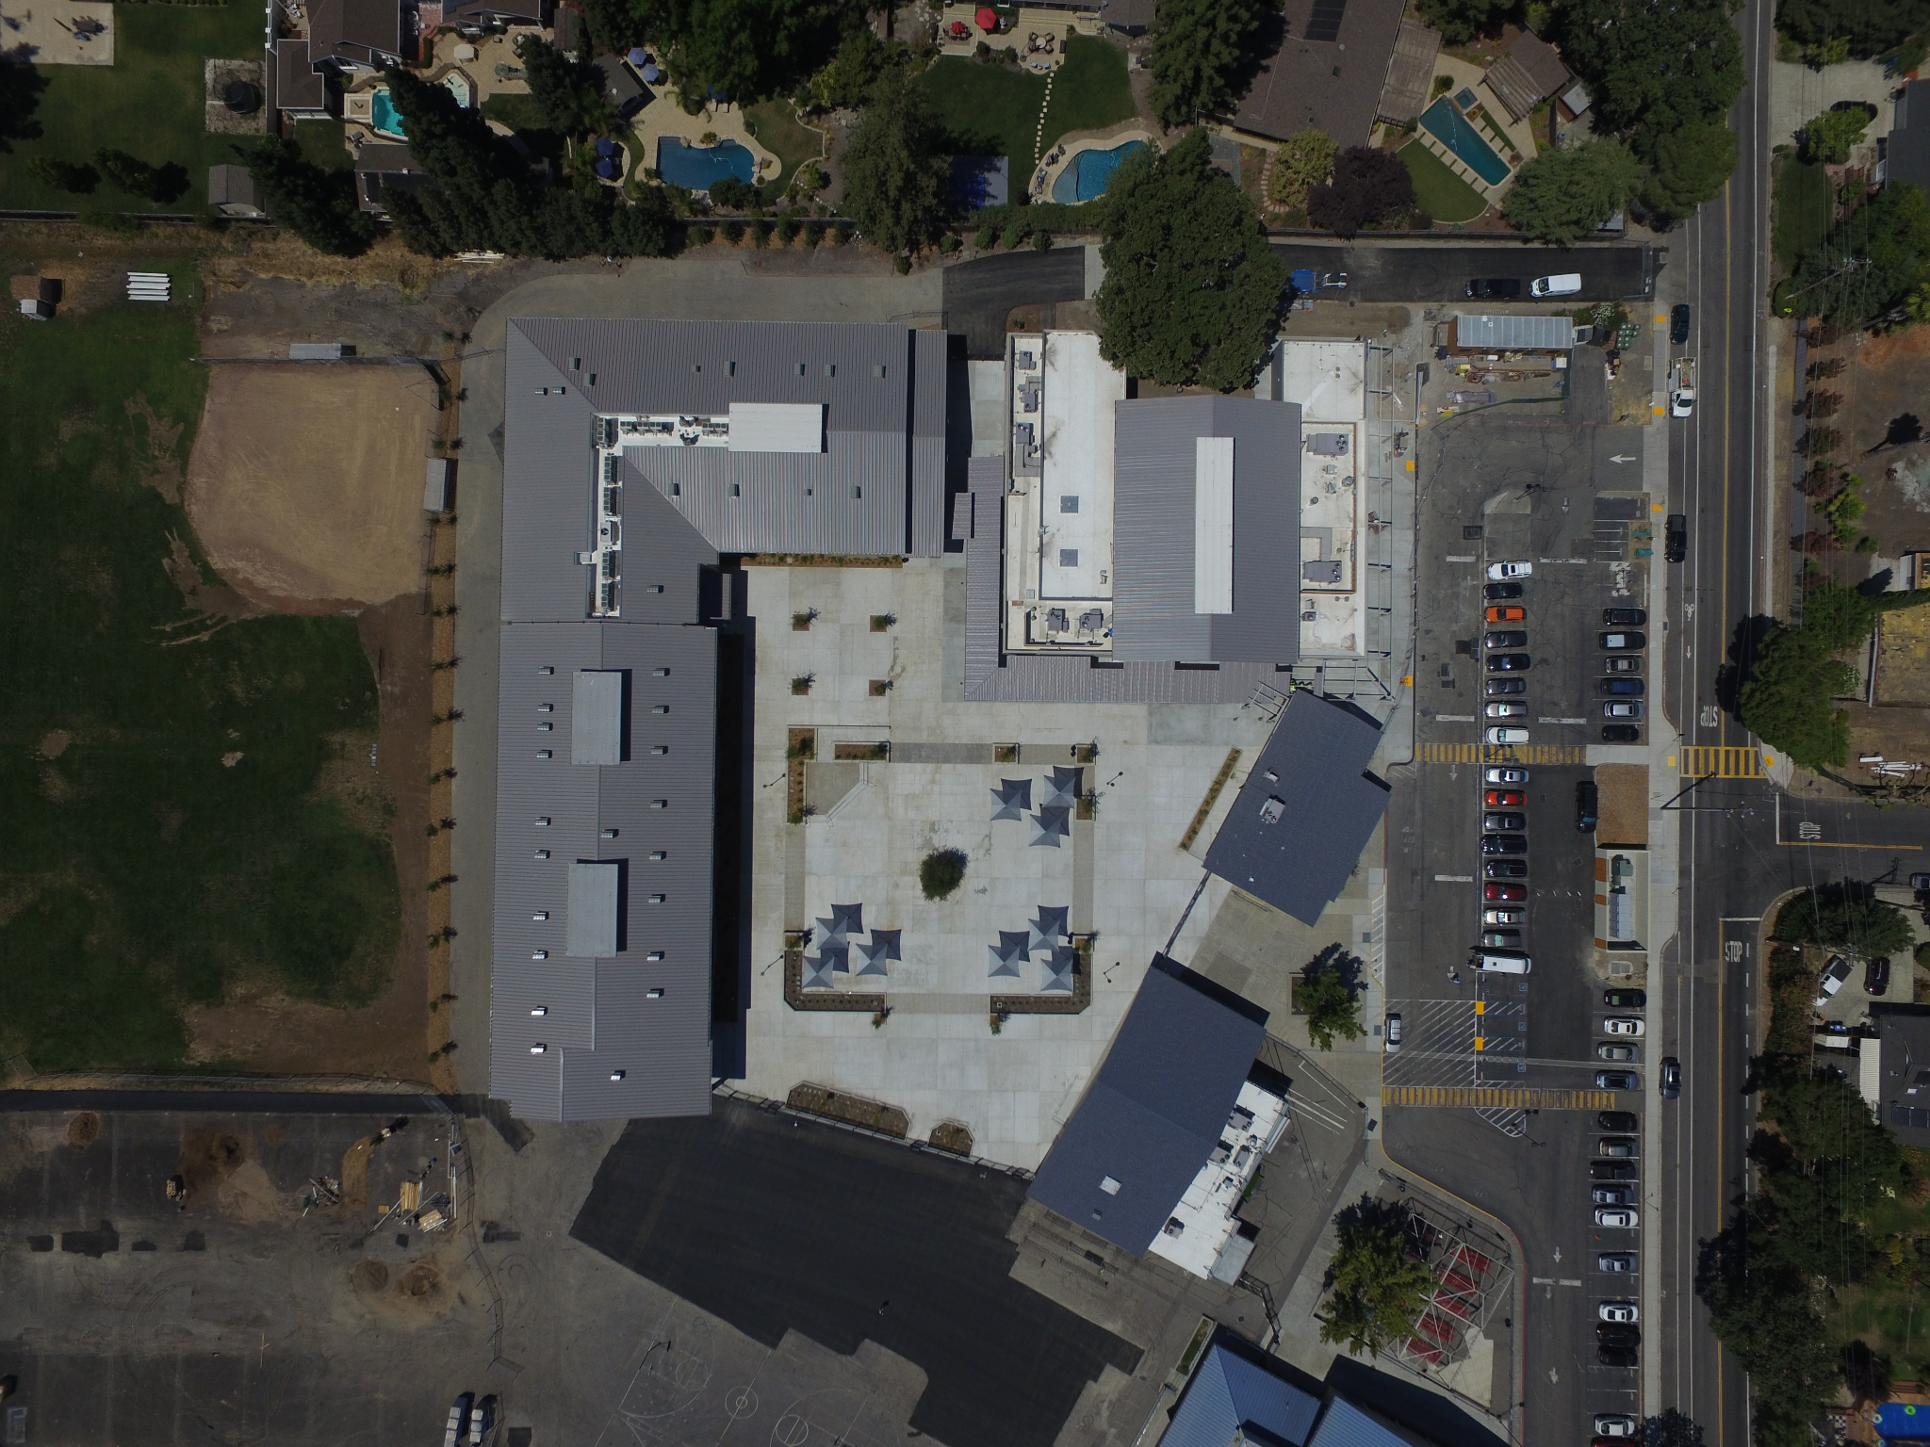
New Construction - Stone Valley Middle
After

Slide 15
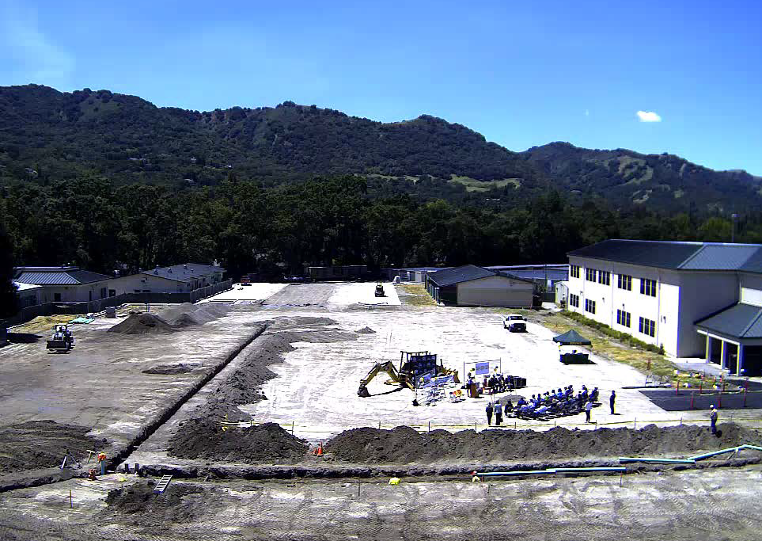
New Construction - San Ramon Valley High

Slide 16
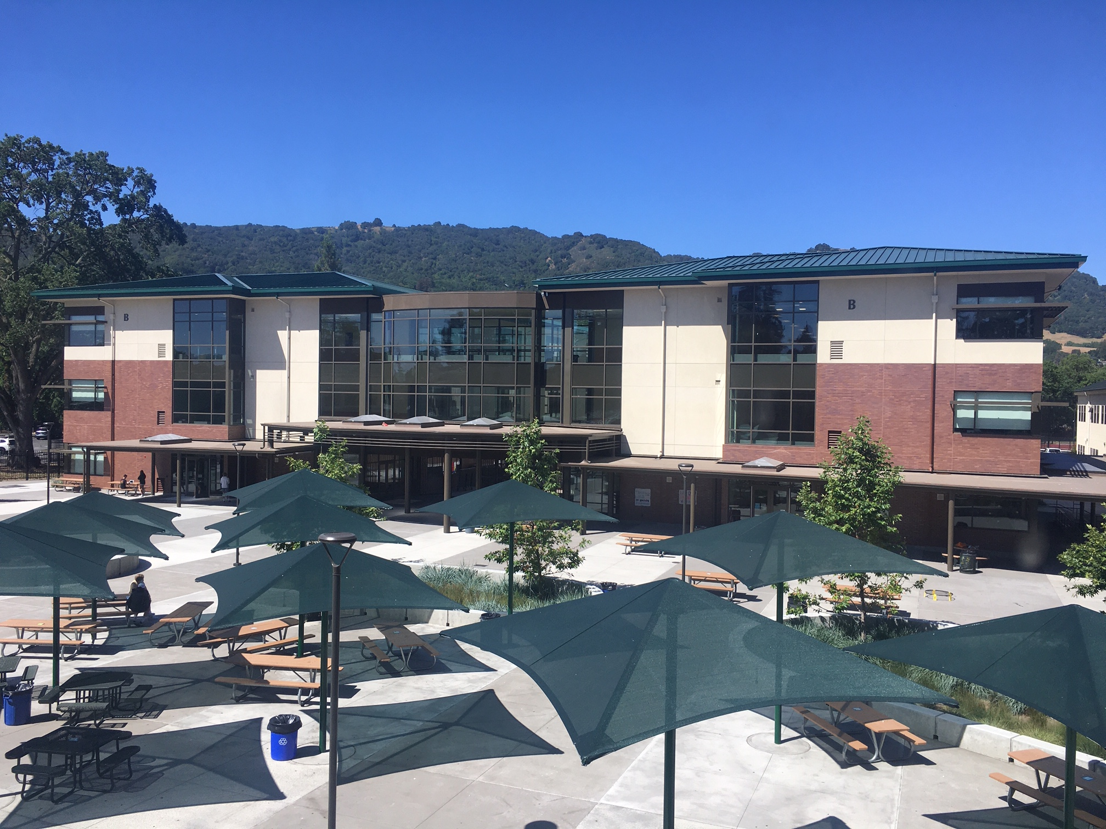
New Construction - San Ramon Valley High

Slide 17
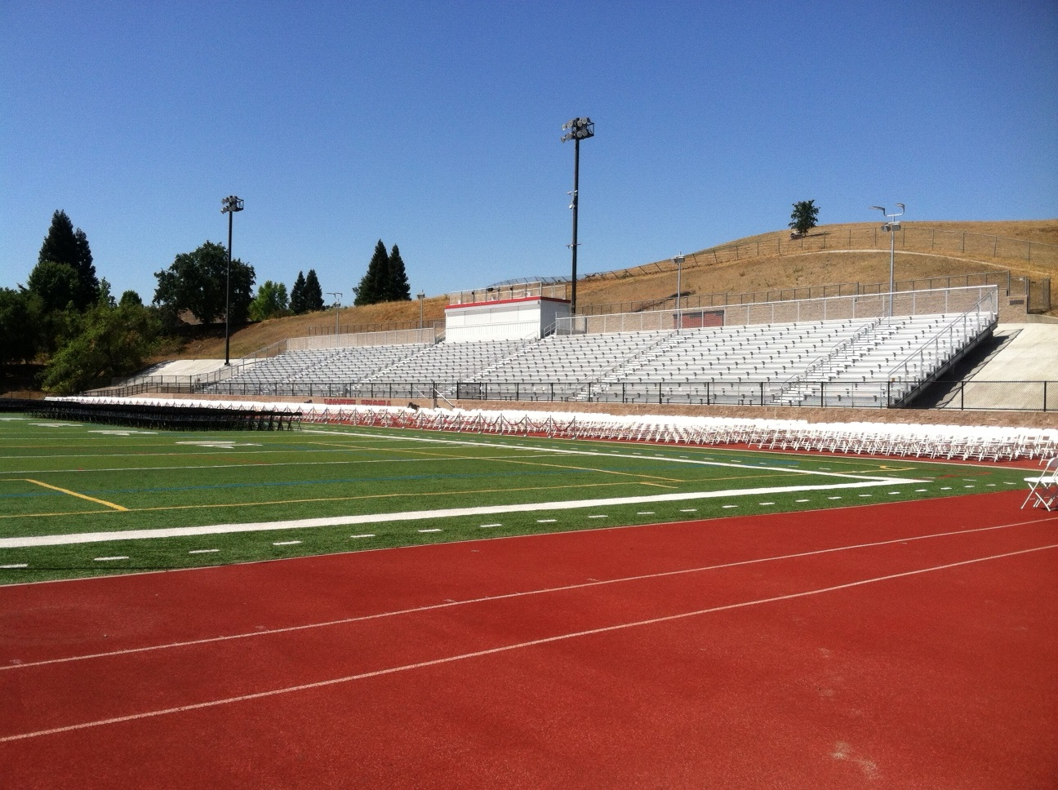
Monte Vista - Bleacher Replacement

Slide 18
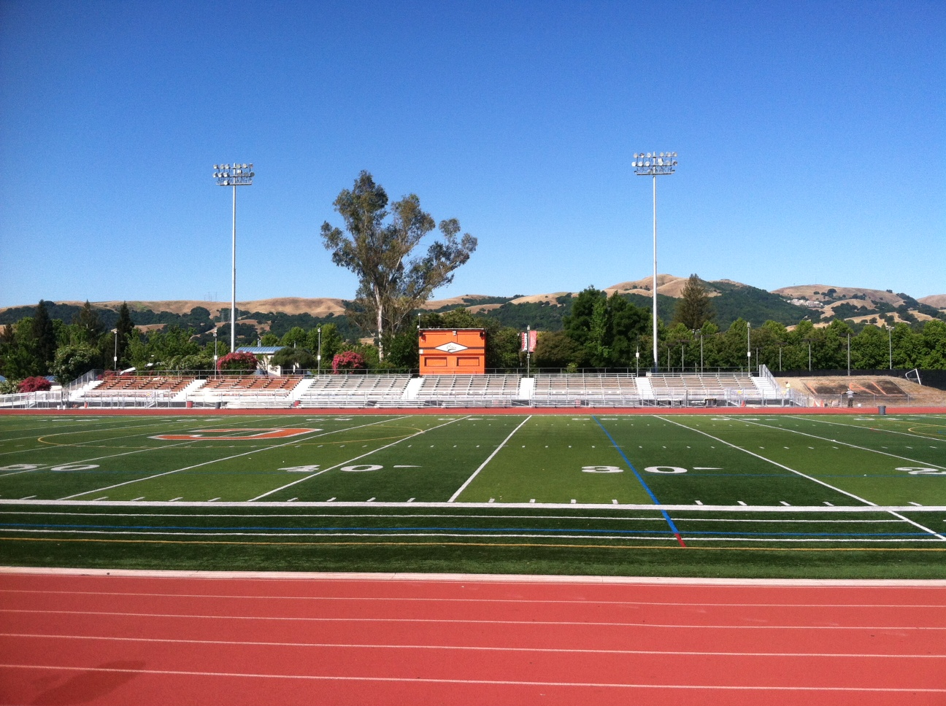
Cal High - Bleacher Replacement

Slide 19
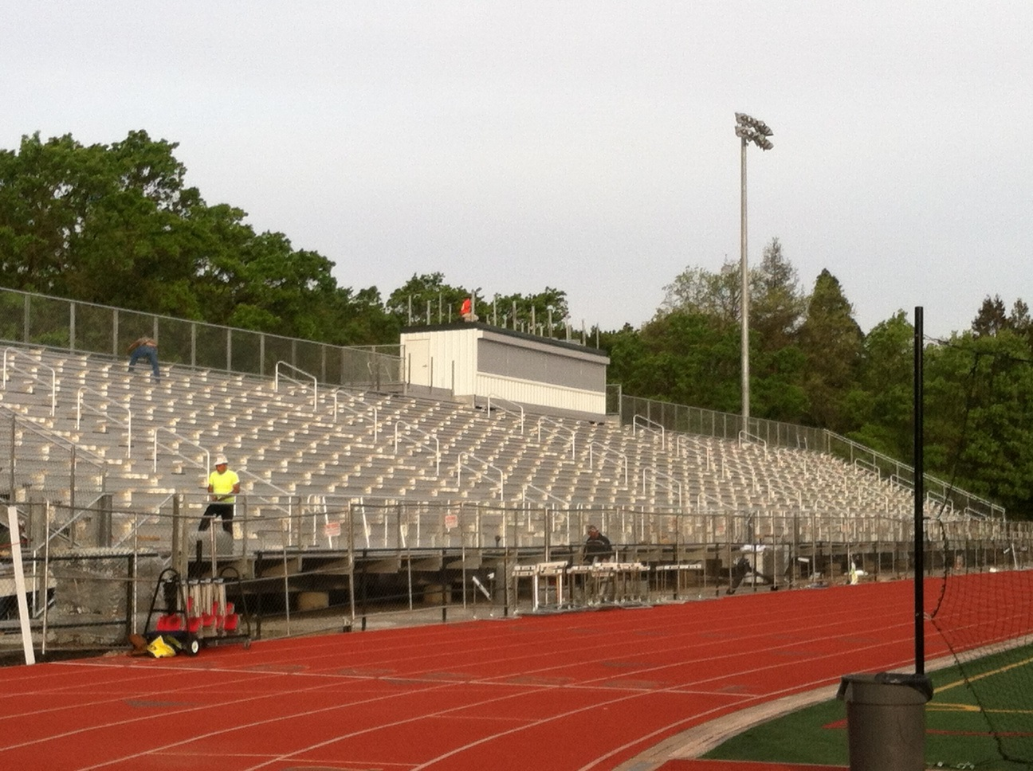
San Ramon Valley HS - Bleacher Replacement

Slide 20
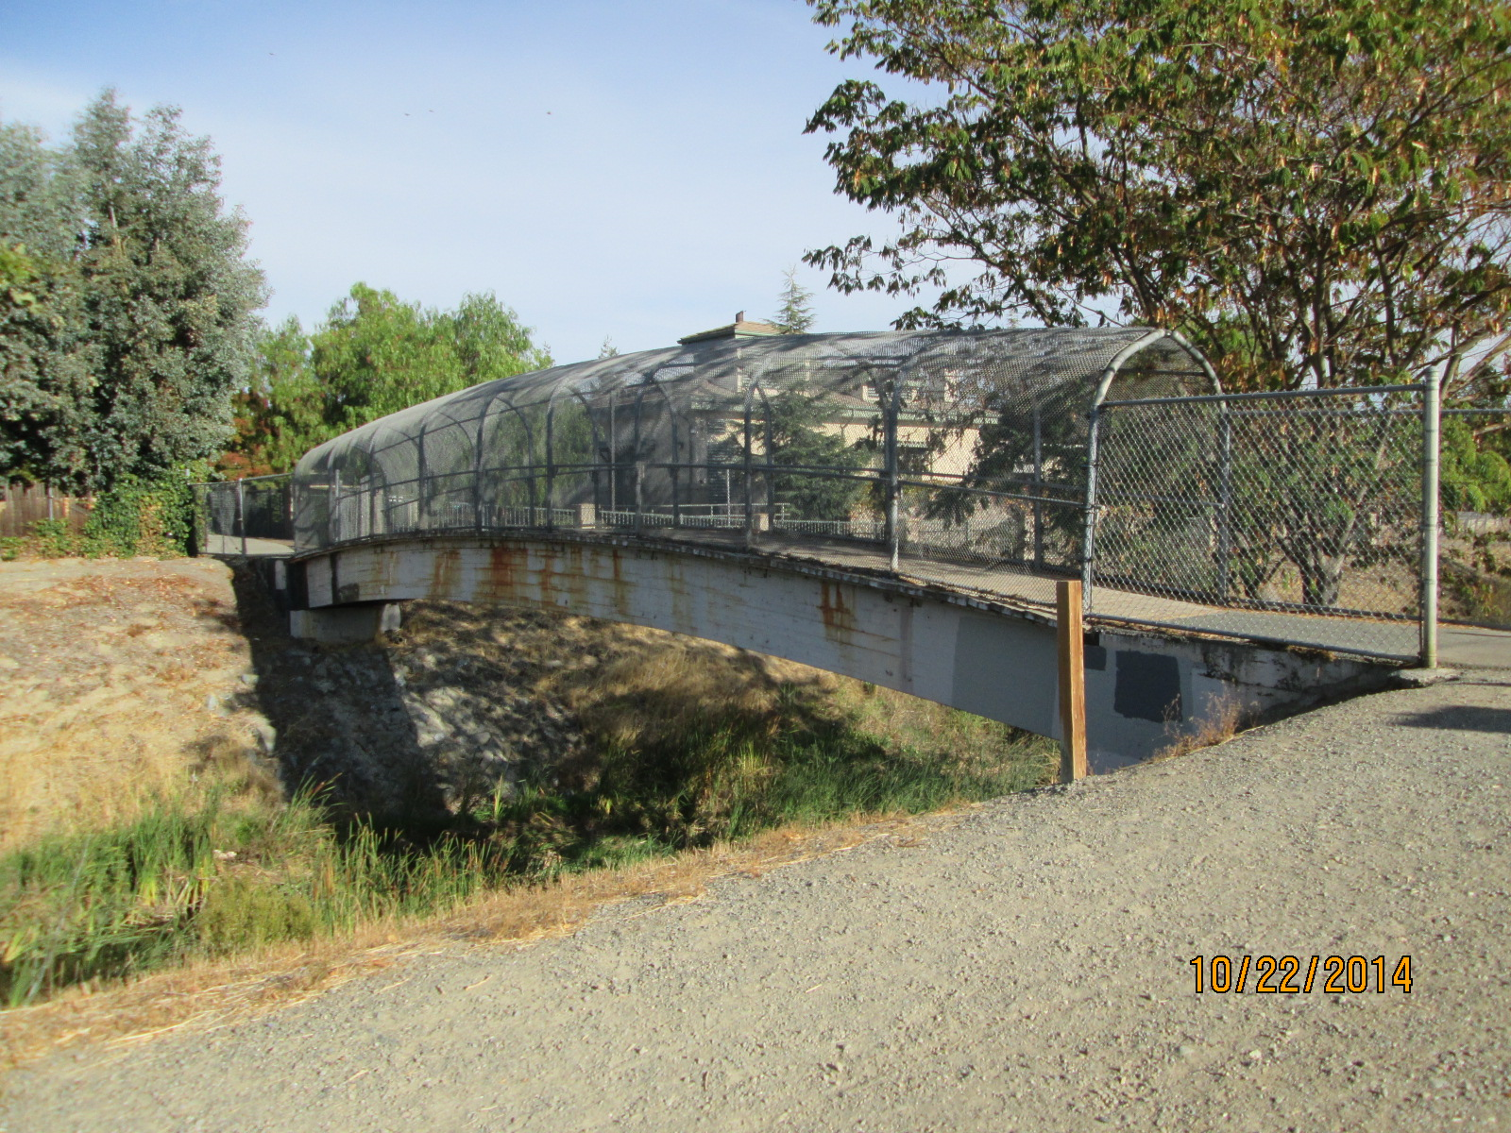
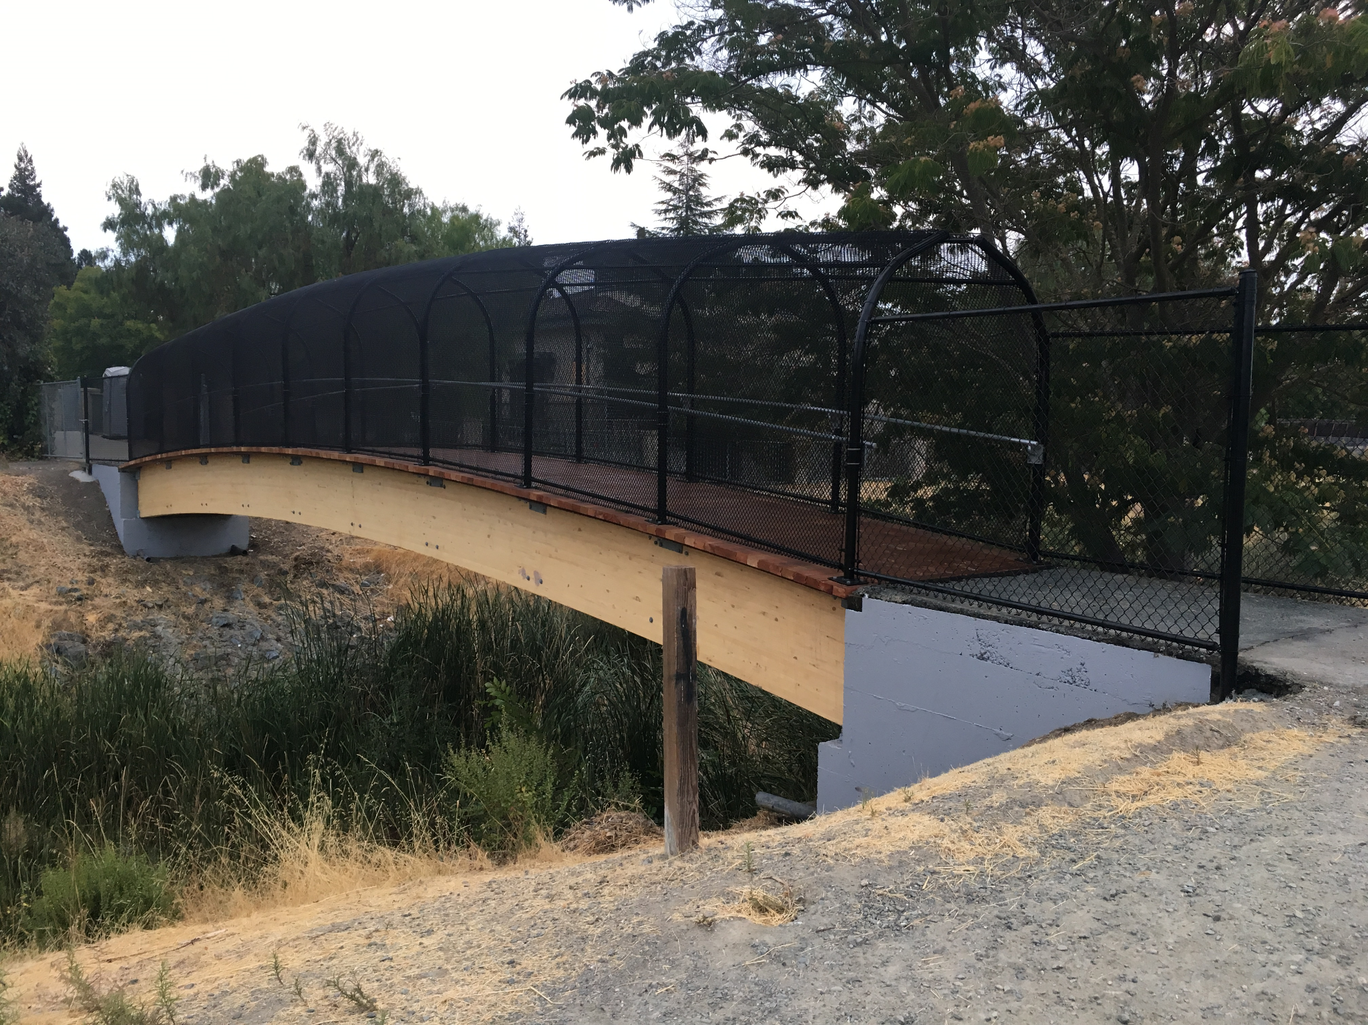
Cal High - Pedestrian Bridge

Slide 21
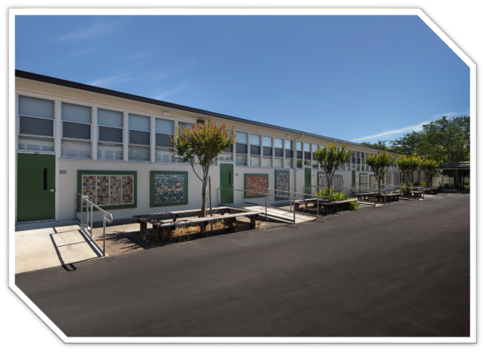
Modernization - Green Valley Building Project

Slide 22
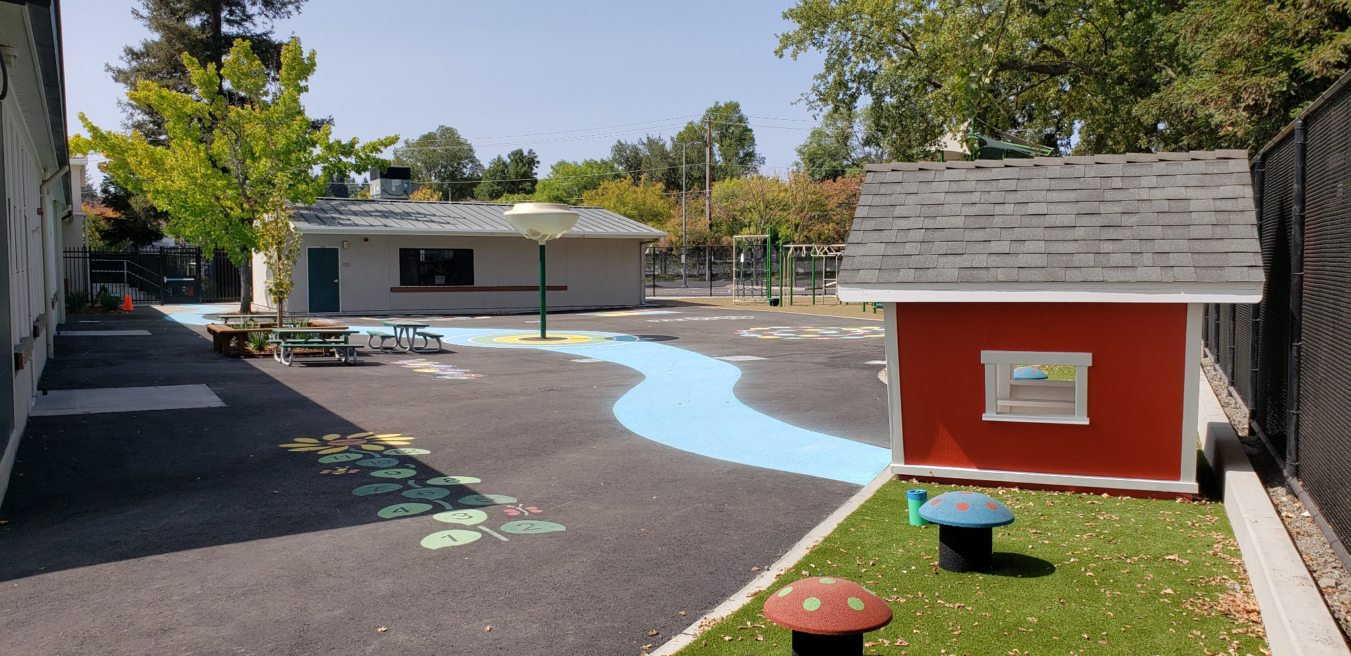
Modernization - Green Valley K-Yard Improvements

Slide 23
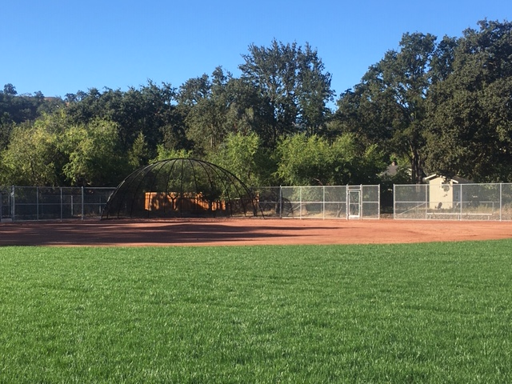
Modernization - Stone Valley Field Renovation

Slide 24
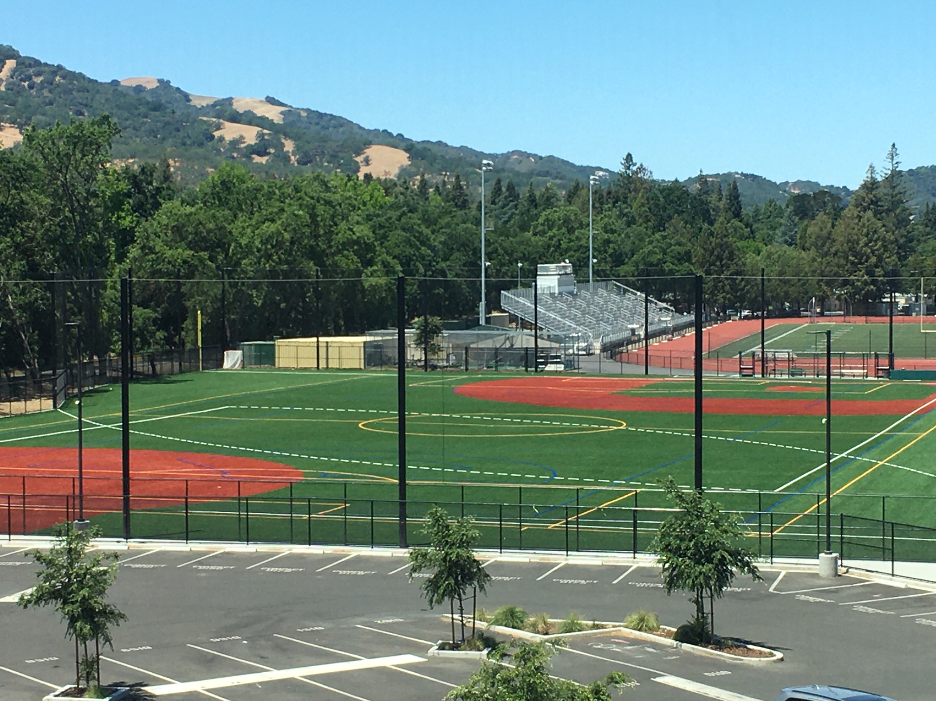
Modernization - SRVHS Multi-Use & Varsity Softball Fields

Slide 25
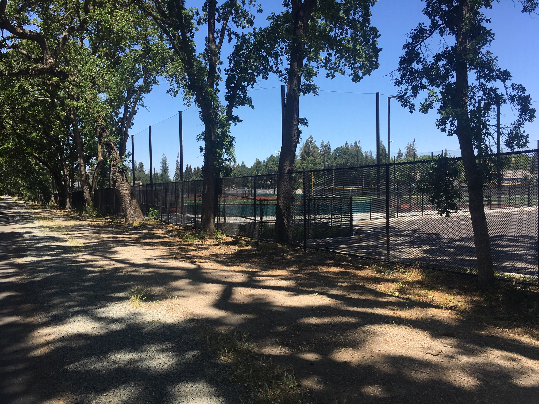
Modernization - SRVHS Iron Horse Trail Fence Replacement

Slide 26
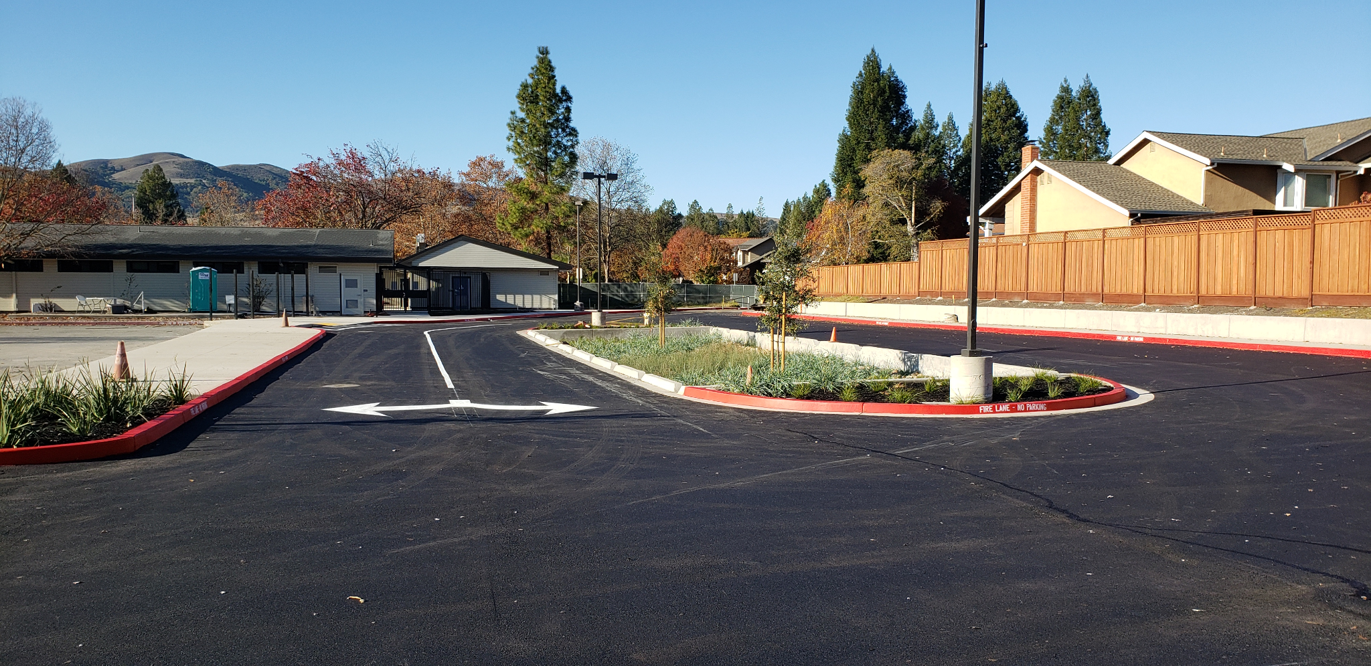
Modernization & Growth - Montevideo Parking Lot Improvements

Slide 27
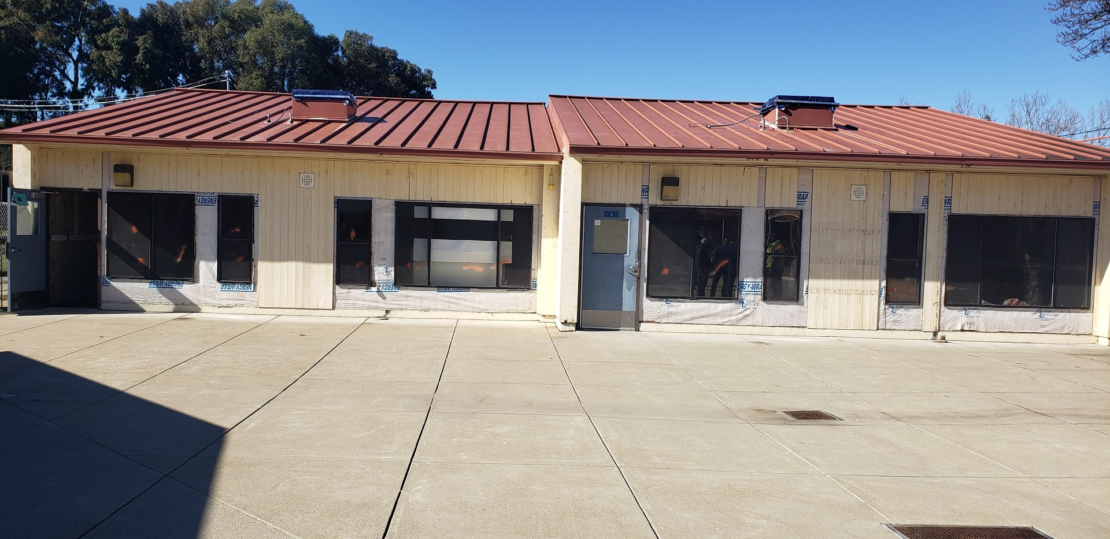
Modernization & Growth - Twin Creeks
Before

Slide 28
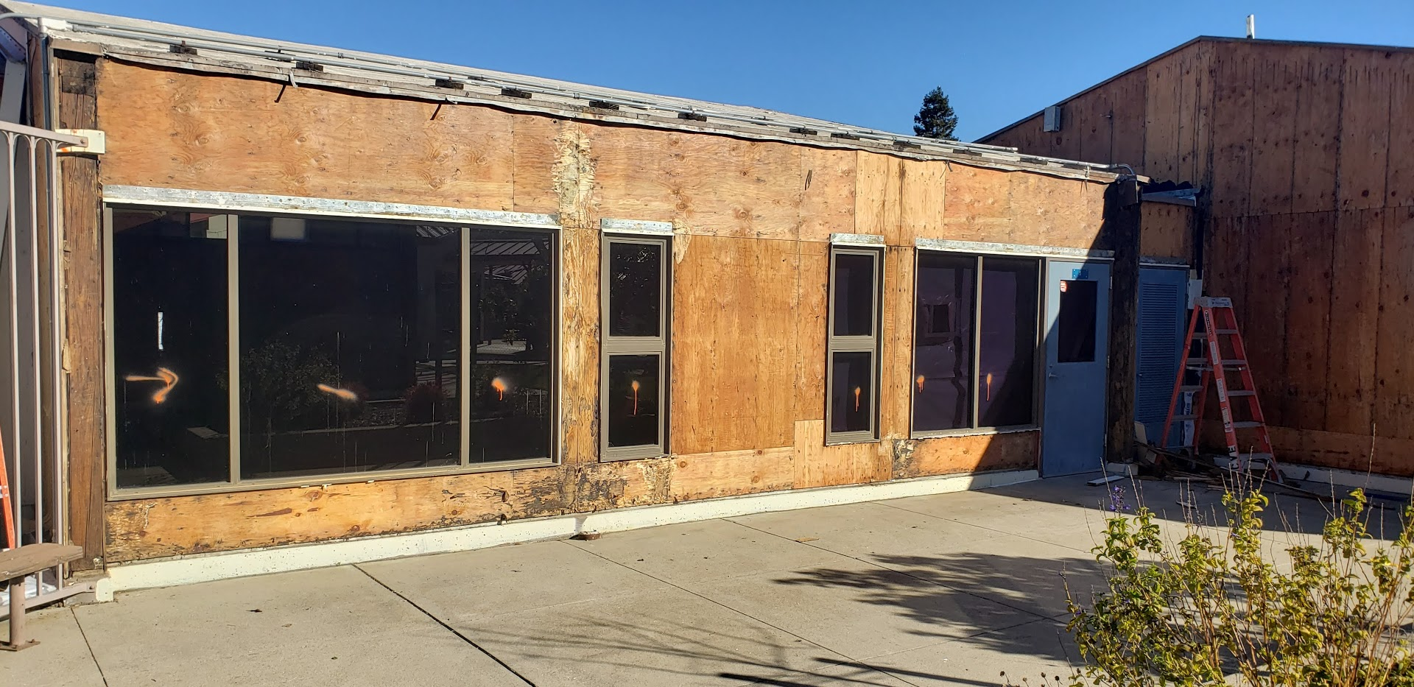
Modernization & Growth - Twin Creeks
In-progress

Slide 29
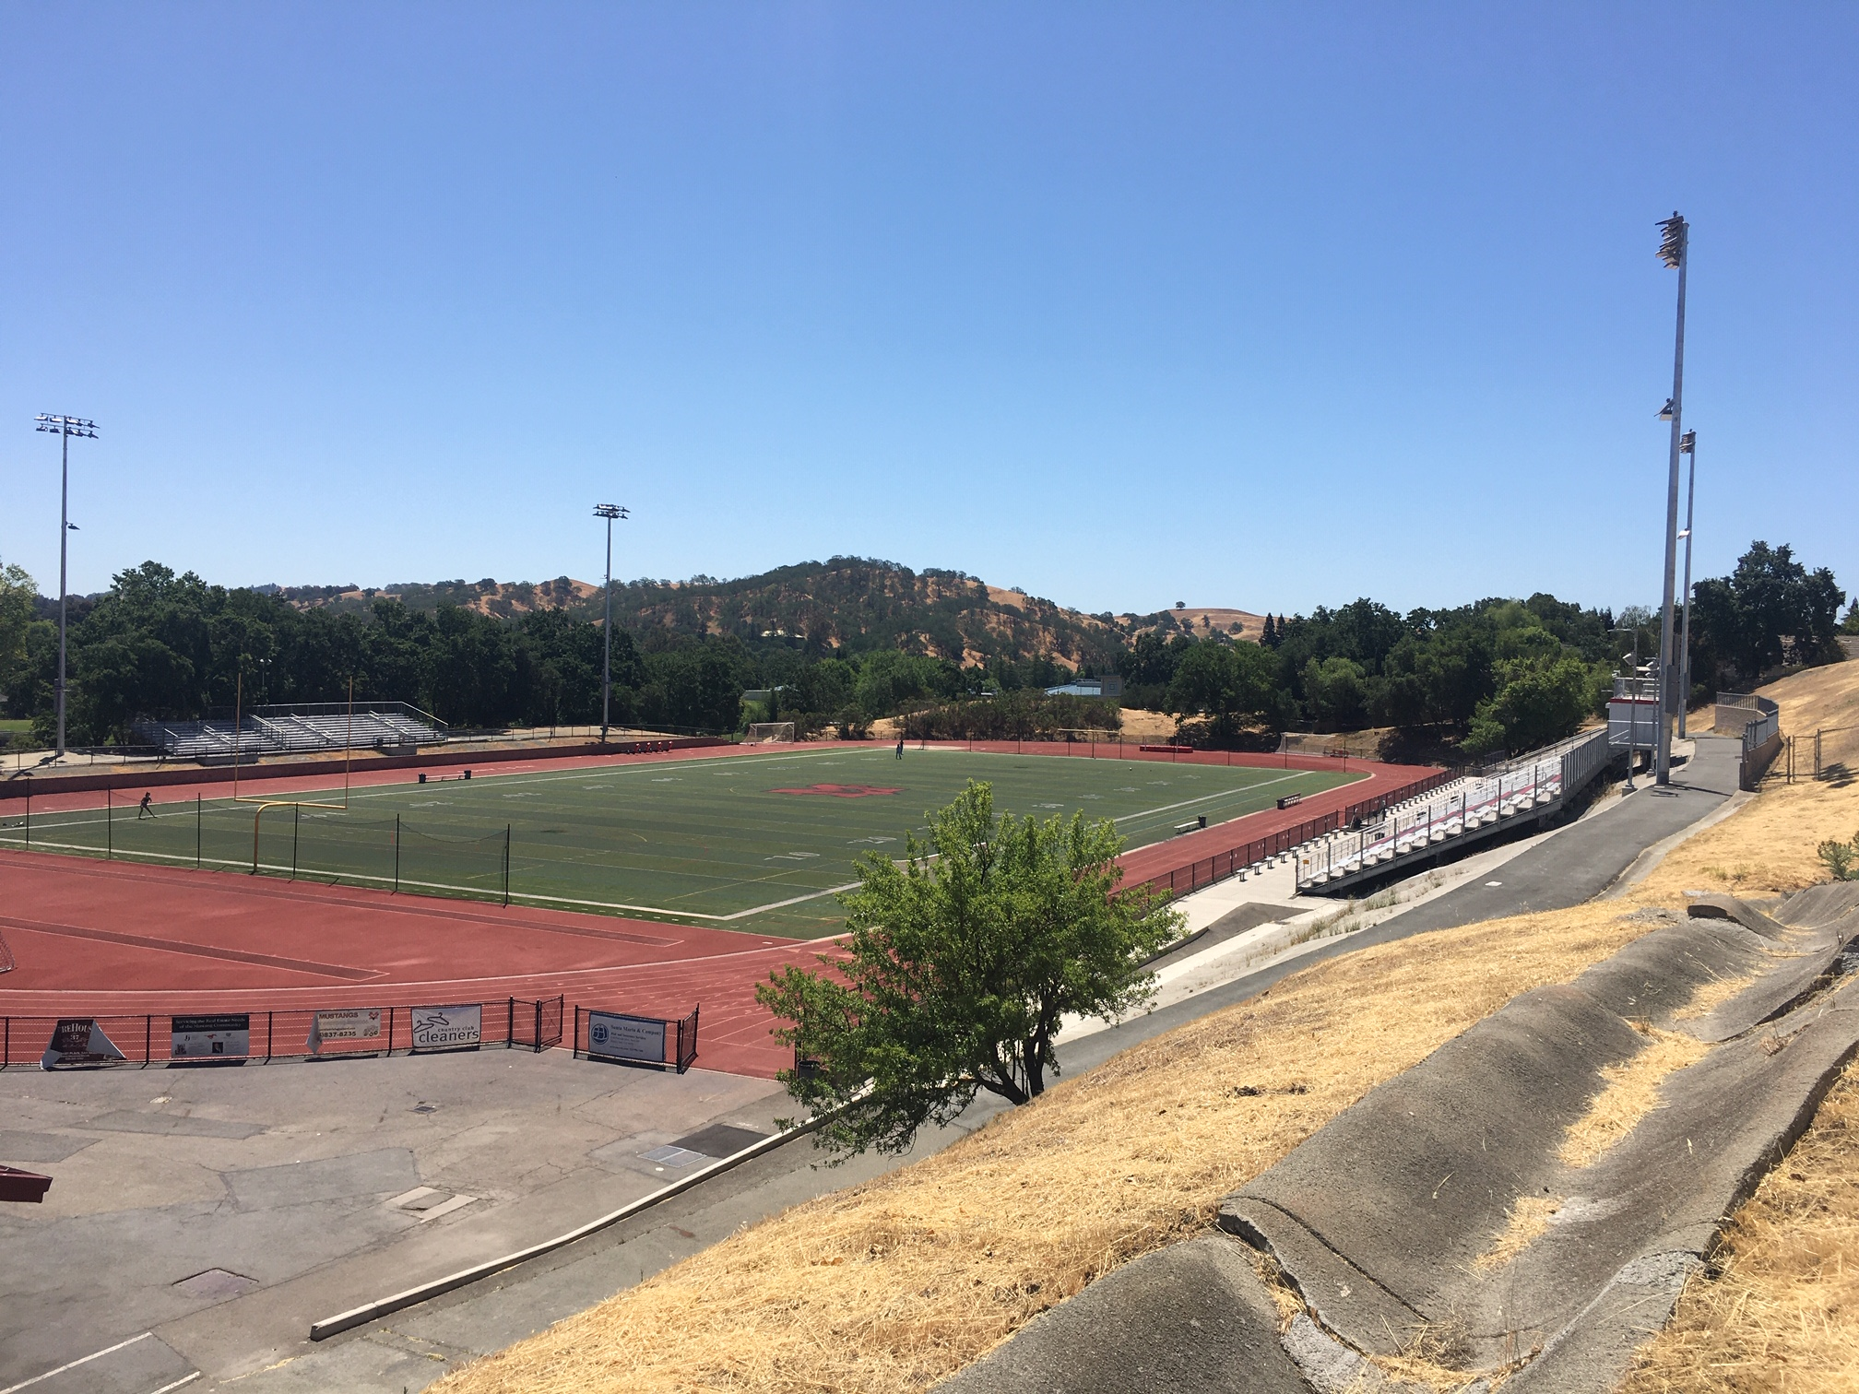
Modernization - Monte Vista Stadium Lights

Slide 30
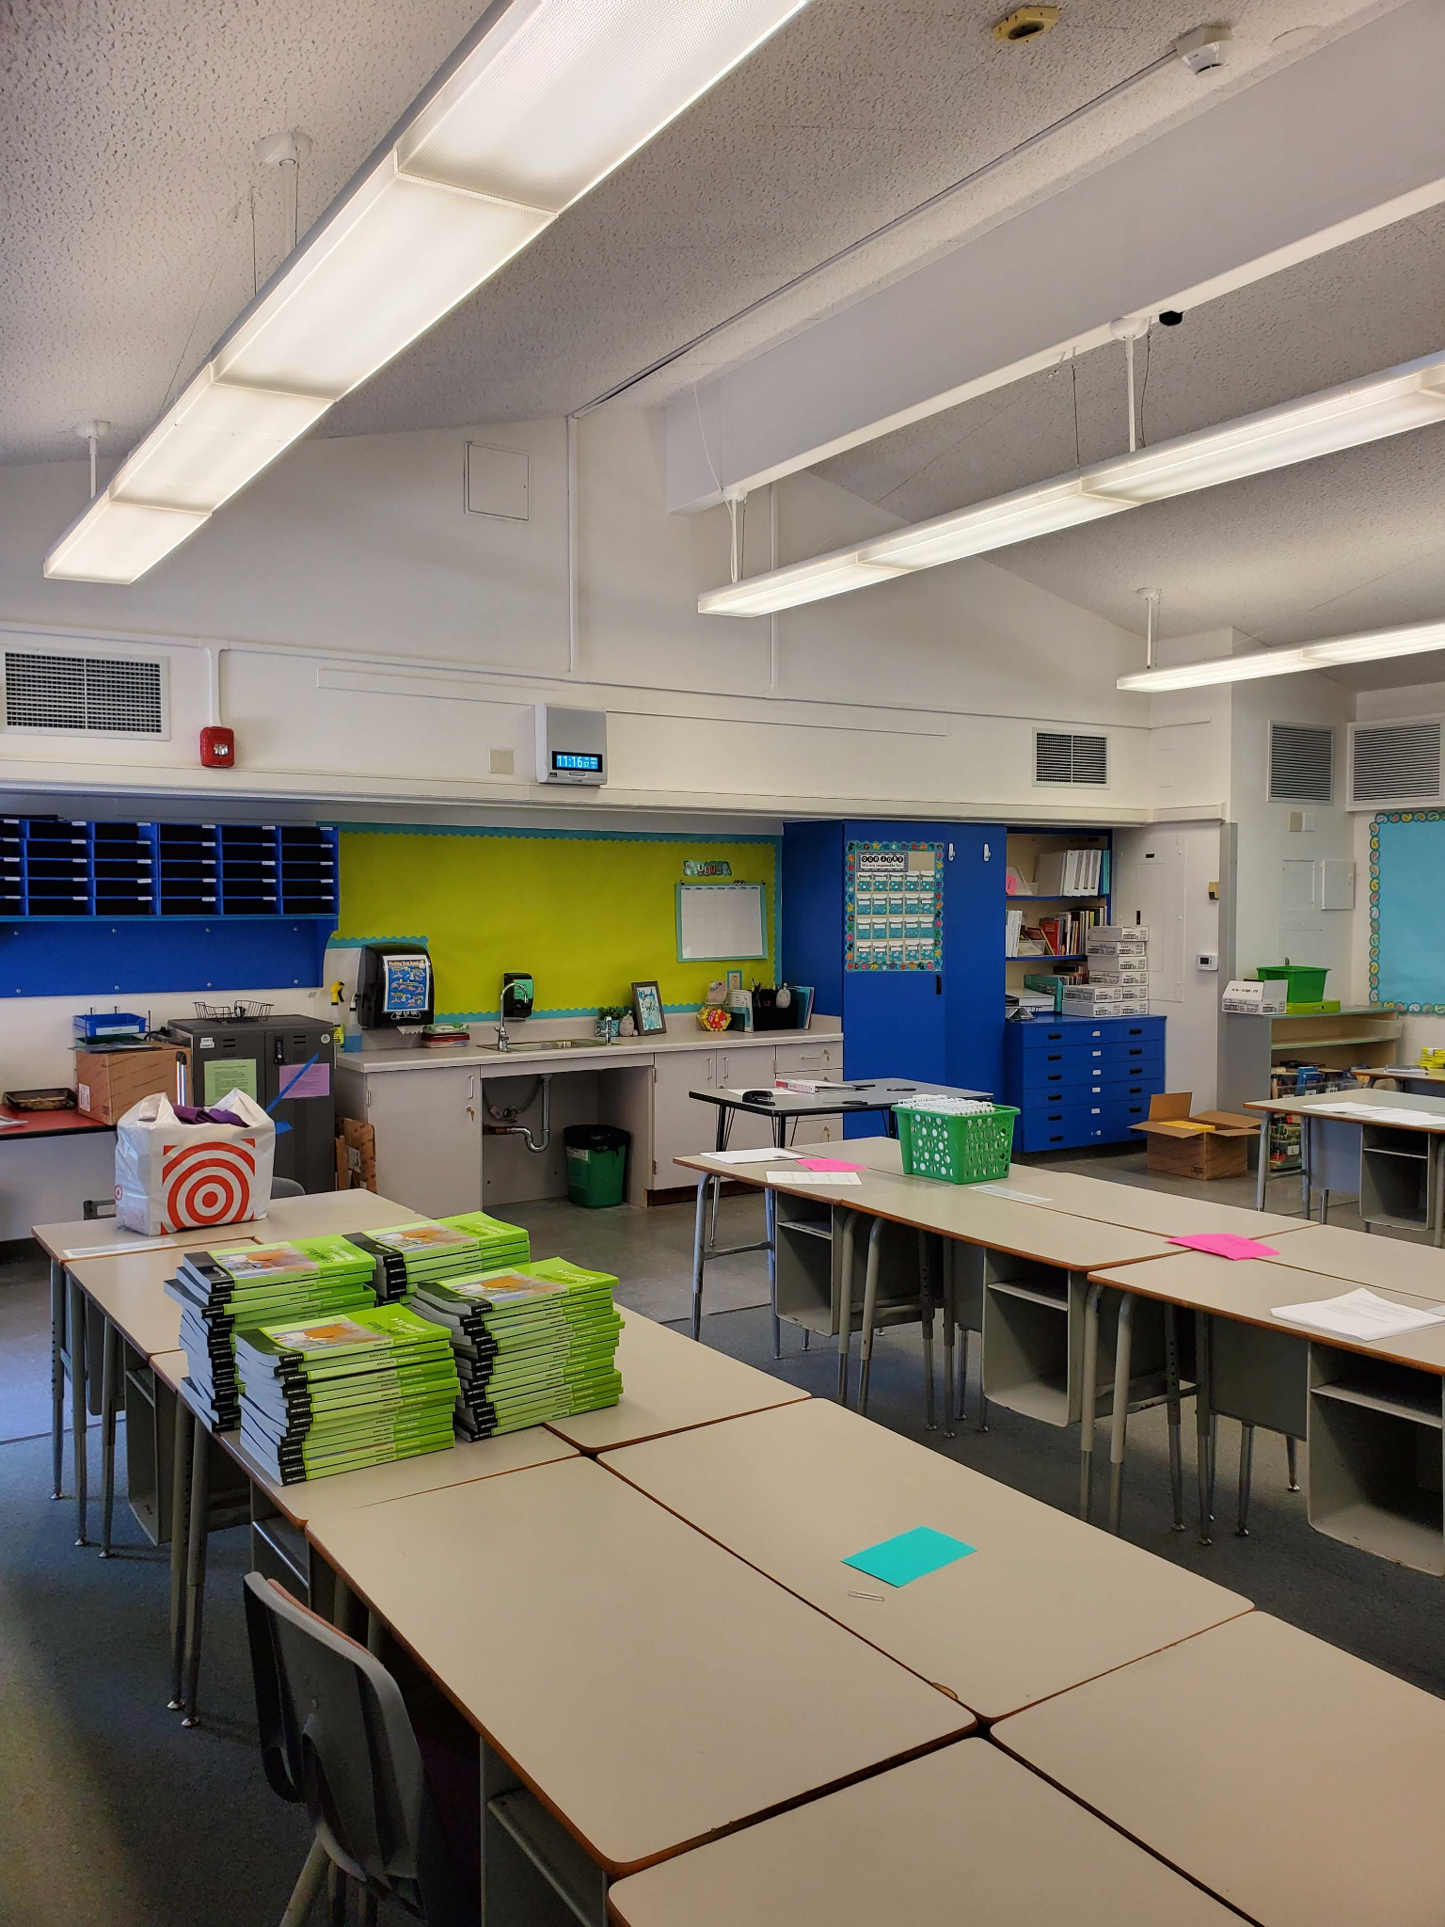
Modernization - Sycamore Valley

Slide 31
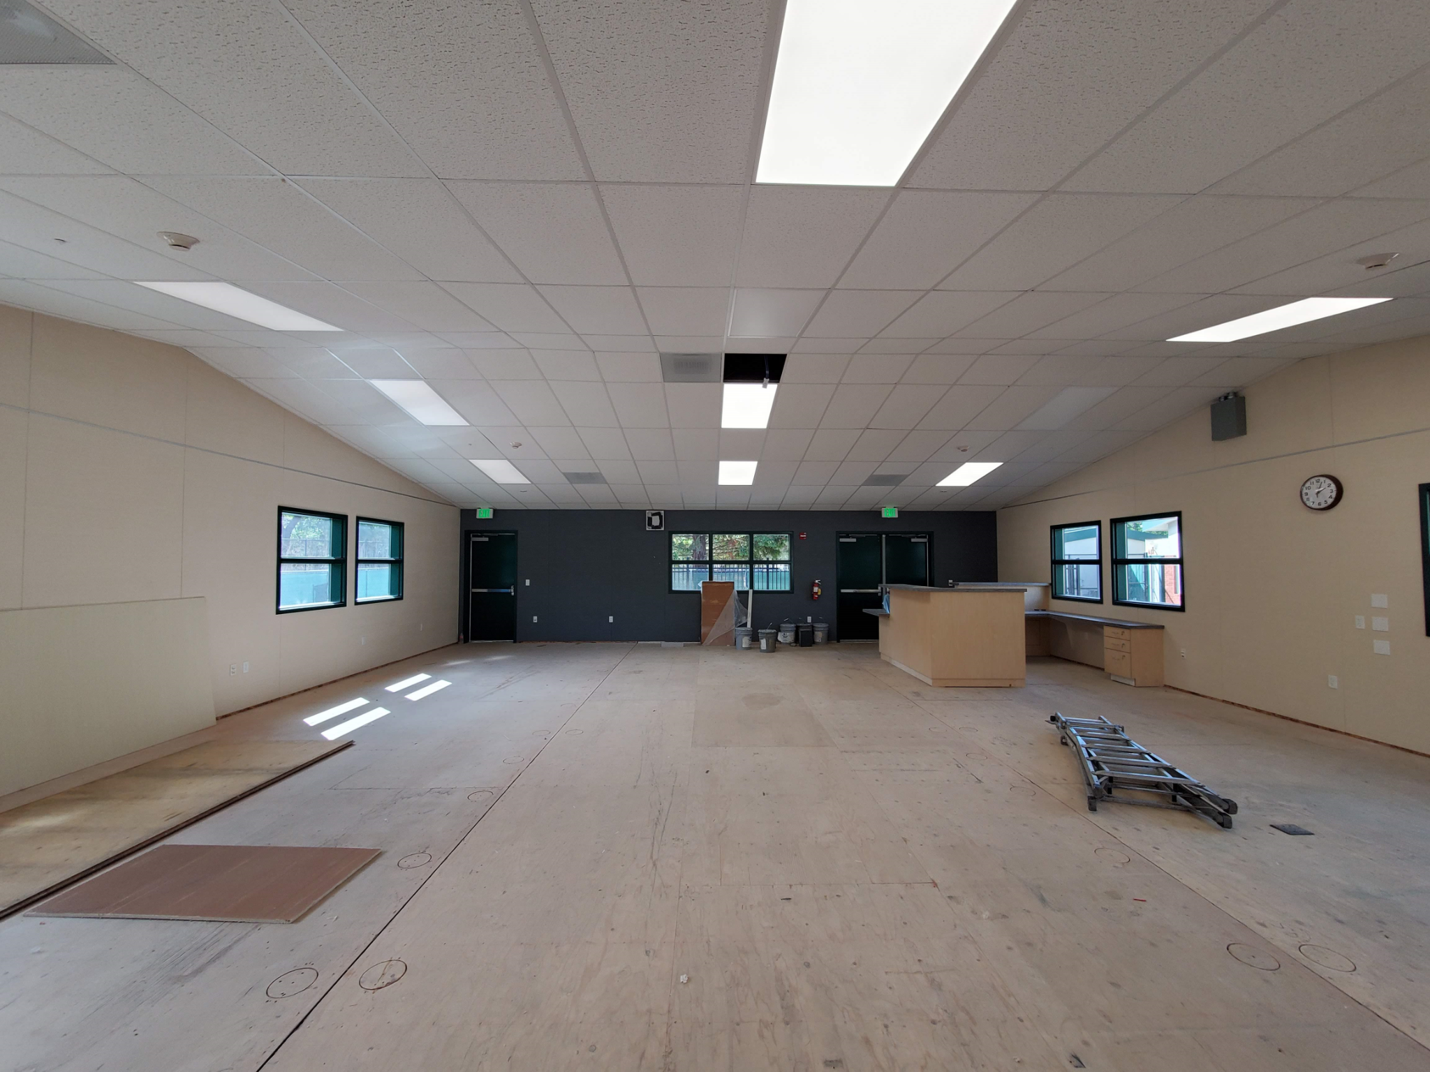
Modernization - Charlotte Wood

Slide 32
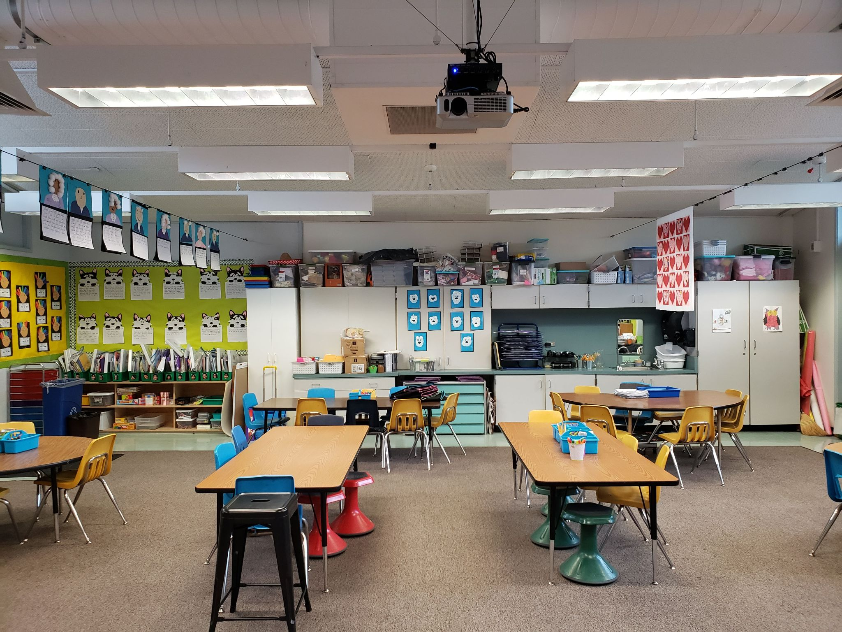
Modernization - Rancho Romero
Rancho Romero Mod before
Rancho Romero Mod
after

Slide 33
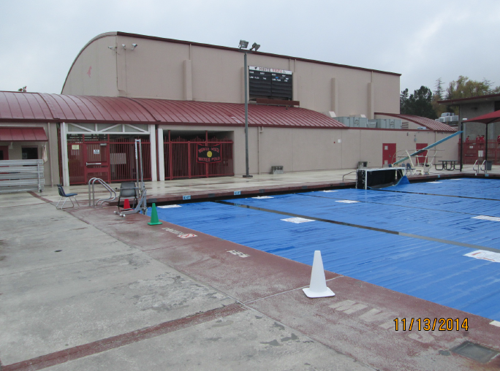
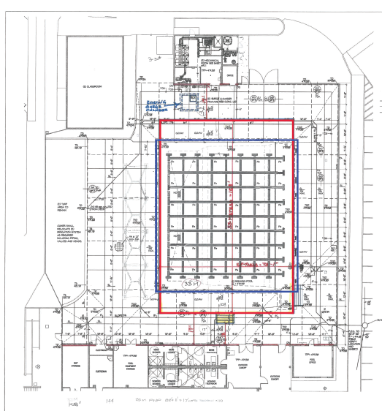
In-Progress: Monte Vista High School Pool Renovation
33-meter pool

Slide 34
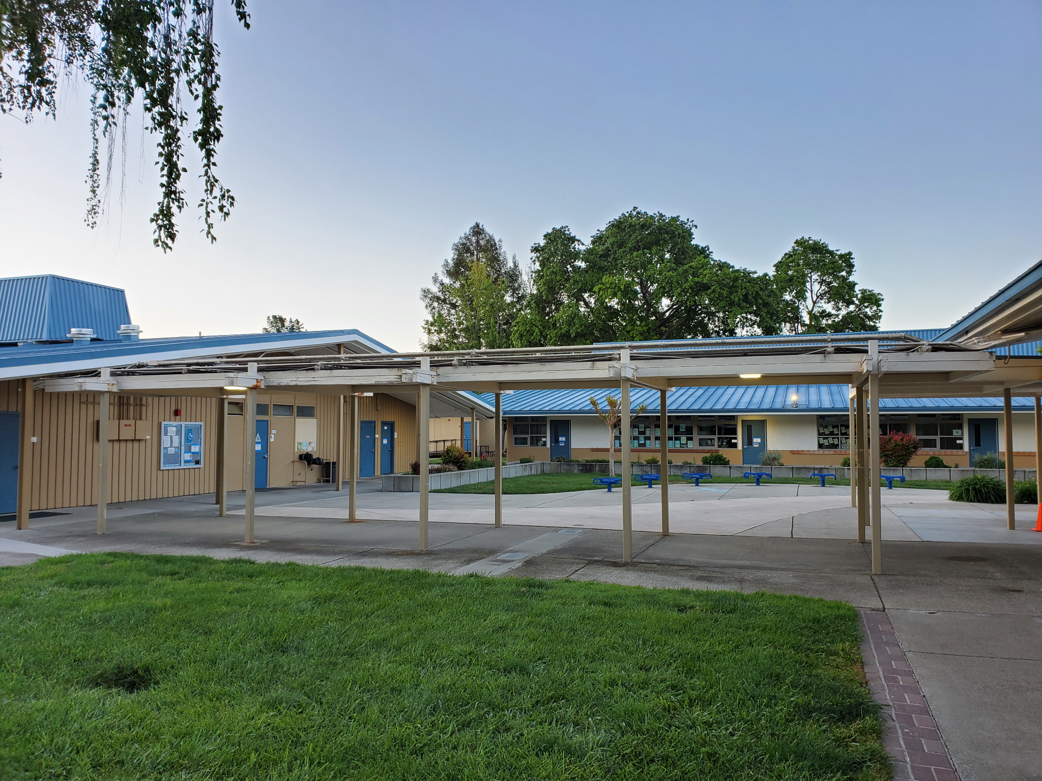
In-Progress: Vista Grande Covered Walkway

